Slide 1
GPIO driver validation report
Baranidharan KARUPPUSAMY

Slide 2
Driver development using BDD
Plot (used for validation report)
parse_log.py
Outputs.txt
Inputs.txt (Data for IO in 10ms samples)
generate_inputs.py
Start here
Test code
(Main.c to validate the driver & App)
GPIO driver + App code (Submodule to delivered)

Slide 3
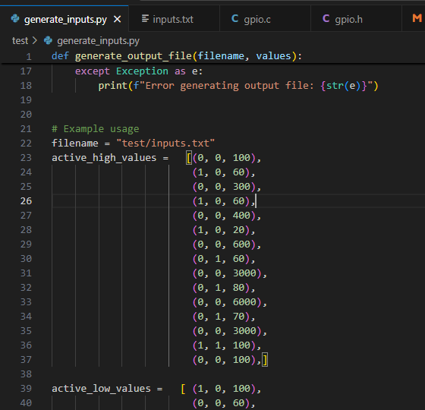
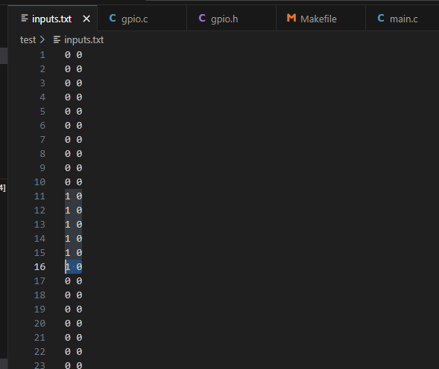
Sample input data
Data for IO in 10ms samples
1 for HIGH
0 for LOW
First data PB1
Second data PB2
Generated programmatically

Slide 4
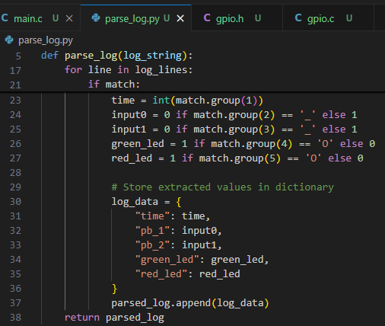
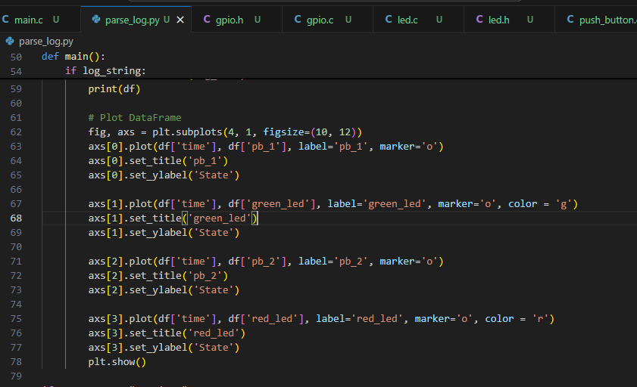
Parsing output data
Output data parse to extract input, output & timing information to dataframe
Dataframe plotted for inference

Slide 5
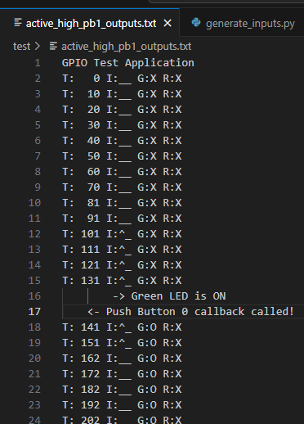
Sample output data
Output by test code in 10 ms task
T -> time in milliseconds since program start
I -> GPIO input status
_ indicates LOW and ^ indicates HIGH state
G & R are GPIO output status for GREEN and RED LESs
O indicates ON and X indicates OFF state
Also shows code execution flow as nested log
50ms debounce, log entry is output after the actual process of inputs

Slide 6
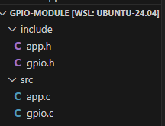
Actual driver code to be used in complex app

Slide 7
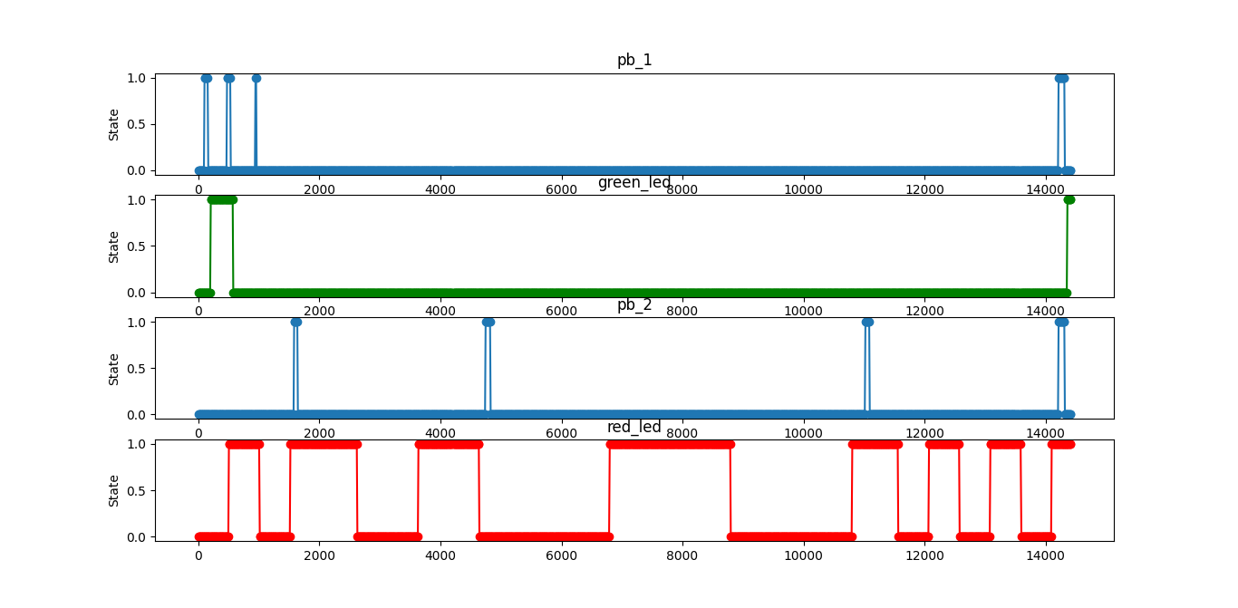
Active high PB1
After valid debouce (50 ms) of pb1 callback toggles green LED
Input without valid debouce of pb1 ignored

Slide 8
PB2
Before pb2 activation red LED toggles at 500ms interval
After first pb2 activation red LED toggles at 1000ms interval
After second pb2 activation red LED toggles at 2000ms interval
After third pb2 activation red LED toggles rollback at 500ms interval

Slide 9
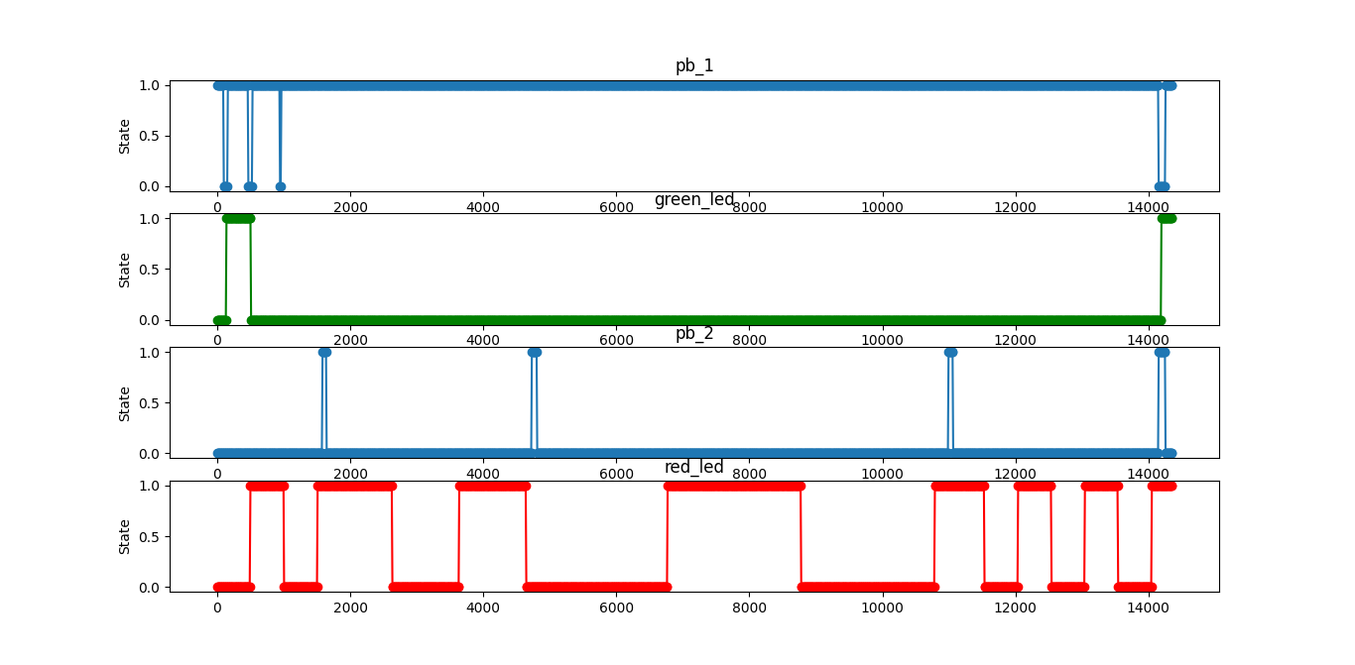
Active low PB1
After valid debouce of pb1 callback toggles green LED
Input without valid debouce of pb1 ignored

Slide 10
Future improvements
Currently input are generated programmatically, this can be further enhanced using python behave that would make defining dynamic behaviour much easier
Output is validated by manual inspection with behave can be validated systematically and validate against system requirement.
Then this can be integrated to build process (CICD) validating against spec each time code being modified.
This approach will enhance software system functional reliability considerably, next time no need to debug entire system for a trivial software bug which can be easily capture in the CICD build process itself.

